Slide 1
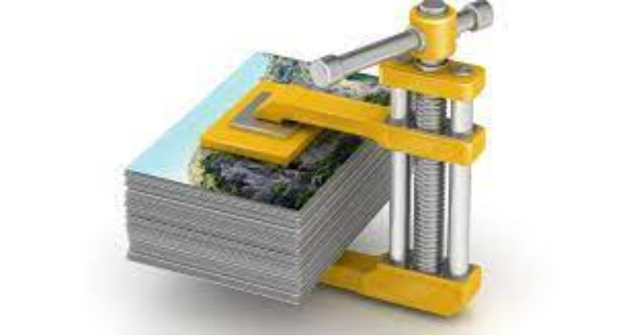
Unit 1.3 - File Compression
Prepared by: Koh Kian Hua

Slide 2
Objectives
After completing this unit, students should be able to:
Show understanding of the need for and examples of the use of
compression
Show understanding of lossy and lossless compression and justify the use
of a method in a given situation
Show understanding of how a text file, bitmap image, vector graphic and
sound file can be compressed
Explain the use of run-length encoding (RLE)

Slide 3
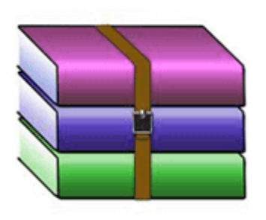


File Compression
Key Terms
File Compression: A process of reducing the size of a file by re-encoding the file data to use fewer bits of storage than the original file.
Popular File Compression Software
Winzip 7-zip WinRAR

Slide 4
File Compression
File Compression Methods
There are two methods of file compression, namely:
  Lossless file compression
  Lossy file compression
Lossless file compression: compression method that enables the original file to be restored following decompression (eg: TIFF, BMP, PCX).
Lossy File Compression: compression method where parts of the original file cannot be recovered during decompression, so some of the original detail is lost. The algorithm used in the lossy technique needs to decide which part of the file are to be kept and which are to be discarded (eg: MP3, JPEG).

Slide 5
File Compression
Compression of Music / Image Files
MPEG-3 (MP3): Use audio compression to convert music and other sounds into an MP3 file format. A 80 MB music file on a CD can be reduced to 8 MB. This MP3 compression technology reduces a normal music file by about 90%.
MPEG-4 (MP4): Allows the storage of multimedia files rather than just sound. Music, videos, photos and animation can be stored in the MP4 format. Videos could be streamed over the internet using the MP4 format without losing any real discernible quality.
JPEG (Joint Photographic Expert Group) : a form of lossy file compression based on the inability of the eye to spot certain colour changes and hues. The JPEG compression algorithm reduces the raw bit-map image by a factor of between 5 and 15, depending on the quality of the original

Slide 6
File Compression
Compression of Music / Audio Files
Audio compression – method used to reduce the size of a sound file using perceptual music shaping.
Perceptual music shaping – method where sounds outside the normal range of hearing of humans, for example, are eliminated from the music file during compression. Only the louder sound can be heard by the ear, so the softer sound is eliminated.

Slide 7
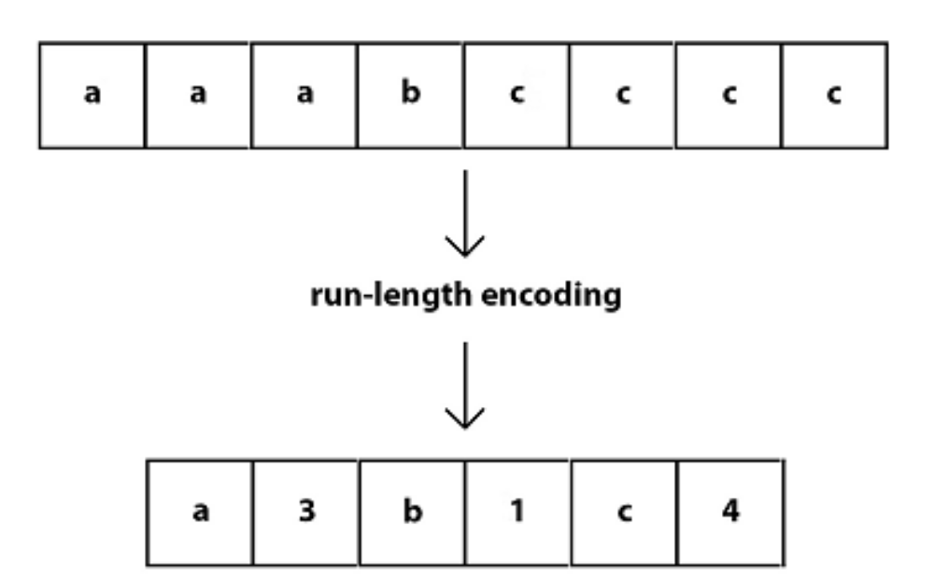
File Compression
File Compression Techniques
Run Length Encoding (RLE) – A form of lossless / reversible file compression that reduces the size of a string of adjacent, identical data (such as repeated colours in an image). It can be used to compress a number of different file formats (eg: tiff, bmp. pcx).

Slide 8
File Compression
Run Length Encoding (RLE)
Run Length Encoding (RLE) – A form of lossless / reversible file compression that reduces the size of a string of adjacent, identical data (such as repeated colours in an image). It can be used to compress a number of different file formats (eg: tiff, bmp. pcx).

Slide 9
File Compression
Run Length Encoding (RLE)
How RLE Works: A repeating string is encoded into two values.
  The first value represents the number of identical data items.
  The second value represents the code (eg ASCII Code) of the data item if it is a keyboard character.
RLE is only effective where there is a long run of repeated units/bits.

Slide 10
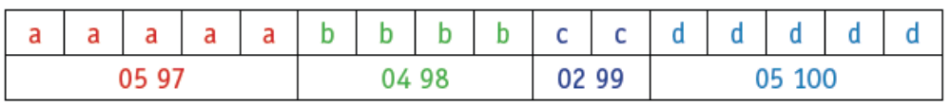
File Compression
Using RLE on Text Data
The text string 'aaaaabbbbccddddd' can be encoded in the format below:
Assuming each character requires 1 byte, then the string needs 16 bytes.
To encode the string, we have the following
5 characters with ASCII code 97,
4 characters with ASCII code 98,
2 characters with ASCII code 99,
5 characters with ASCII code 100.
If each number in the second row requires 1 byte of memory,
the RLE code will need 8 bytes (half the original file size).

Slide 11
File Compression
Using RLE with "Flag" Data
For string such as ‘cdcdcdcdcd’, compression is not very effective.
To cope with this issue, we use a flag preceding the data (number of repeating units).
RLE achieves the following
The coded version (2nd row) reduces the string 18 values and requires 18 bytes of storage.
Introducing a flag (255 in this case) produces:
255 08 97 255 10 98 99 100 99 100 99 100 255 08 101
The RLE code with "flag data" has 15 values (15 bytes) and result in
53% reduction in file size.

Slide 12
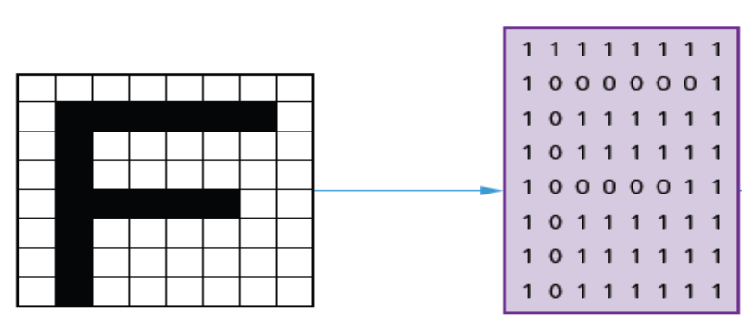
File Compression
Using RLE on Black & White Images
The figure shows the letter F in a grid where each square requires 1 byte of storage
The compressed RLE format produces the folowing data:
9W 6B 2W 1B 7W 1B 7W 5B 3W 1B 7W 1B 7W 1B 6W
Replacing W = 1, and B = 0, the coded data becomes:
91 60 21 10 71 10 71 50 31 10 71 10 71 10 61
The 8 × 8 grid would need 64 bytes; the compressed RLE format has 30 values
requires only 30 bytes to store the image
.

Slide 13
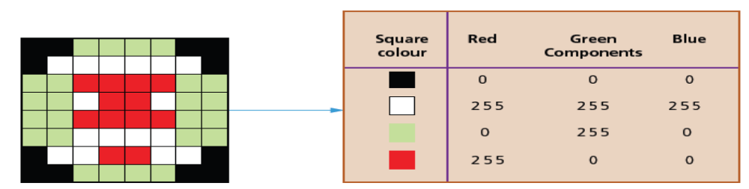
File Compression
Using RLE on Colored Images
The image has 3 colors (Red, Green, blue) according to the code on the right table
The compressed RLE format produces the folowing data:
2 0 0 0 4 0 255 0 3 0 0 0 6 255 255 255 1 0 0 0 2 0 255 0 4 255 0 0 4 0 255 0 1
255 255 255 2 255 0 0 1 255 255 255 4 0 255 0 4 255 0 0 4 0 255 0 4 255 255 255
2 0 255 0 1 0 0 0 2 255 255 255 2 255 0 0 2 255 255 255 3 0 0 0 4 0 255 0 2 0 0 0
The original uncompressed image is a 8x 8 square and assuming 3 bytes per square (for all RGB values)
Requires 8 x8 x3 = 192 bytes
The RLE code has 92 values, which gives a file reduction of about 52%
.

Slide 14
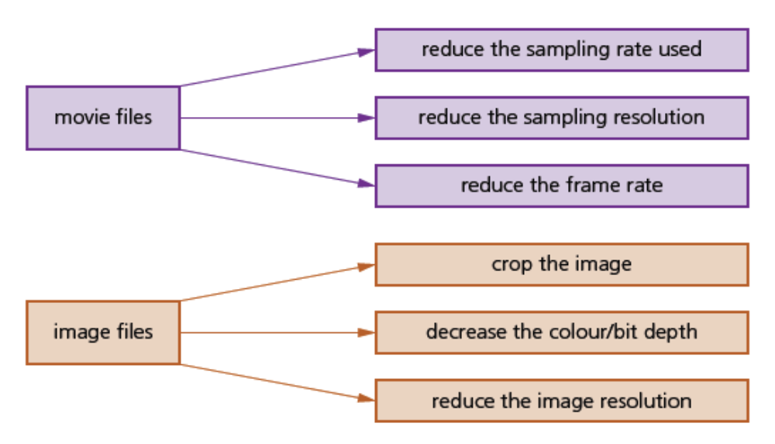
File Compression
General Methods of File Compression (Lossy and Lossless)
.

Slide 15
File Compression
Class Activity
Answer the following questions
.
1 a) What is meant by lossless and lossy file compression?
b) Give an example of a lossless file format and an example of a lossy file format.
2 a) What is meant by run length encoding?
b) Describe how RLE compresses a file. Give an example in your
description.
3) With reference to the following data input
Input:
WWWWWWWWWWWWBWWWWWWWWWWWWBBBWWWWWWWWWWWWWWWWWWWWWWWWBWWWWWWWWWWWWWW
What is the ouput of the RLE encoded data ?

Slide 16
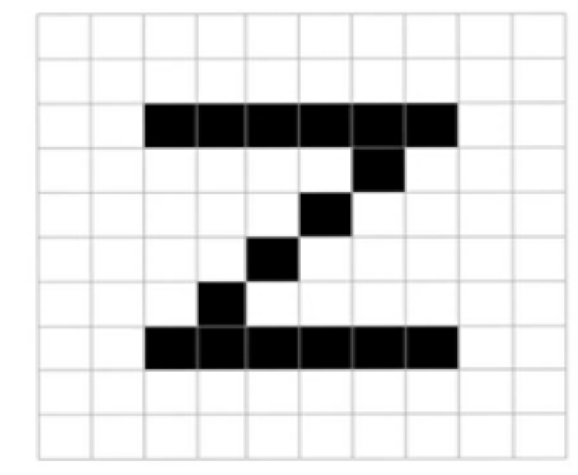
File Compression
Class Activity
4) Write down the RLE coded data for the following image

